Slide 1
Learning Algorithms
TE AIDS
Prof. Shilpa Gaikwad

Slide 2
Learning Algorithms
A learning algorithm is a method used to process data to extract patterns appropriate for application in a new situation.
In particular, the goal is to adapt a system to a specific input-output transformation task.

Slide 3
The list of Top 10 commonly used Machine Learning (ML) Algorithms:
Linear regression
Logistic regression
Decision tree
SVM algorithm
Naive Bayes algorithm
KNN algorithm
K-means
Random forest algorithm
Dimensionality reduction algorithms
Gradient boosting algorithm and AdaBoosting algorithm

Slide 4
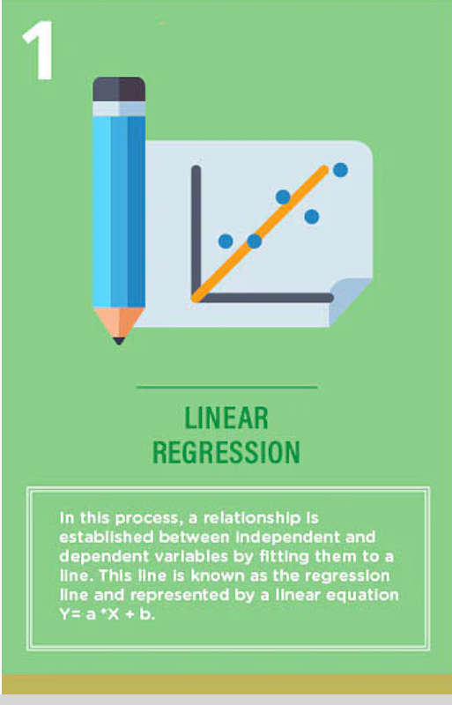
1.Linear regression

Slide 5
1. Linear Regression
1. Linear Regression
To understand the working functionality of Linear Regression, imagine how you would arrange random logs of wood in increasing order of their weight.
There is a catch; however – you cannot weigh each log.
You have to guess its weight just by looking at the height and girth of the log (visual analyses) and arranging them using a combination of these visible parameters.
This is what linear regression in machine learning is like.

Slide 6
1. Linear Regression
In this process, a relationship is established between independent and dependent variables by fitting them to a line.
This line is known as the regression line and is represented by a linear equation
Y= a *X + b.
In this equation:
Y – Dependent Variable
a – Slope
X – Independent variable
b – Intercept
The coefficients a & b are derived by minimizing the sum of the squared difference of distance between data points and the regression line.

Slide 7
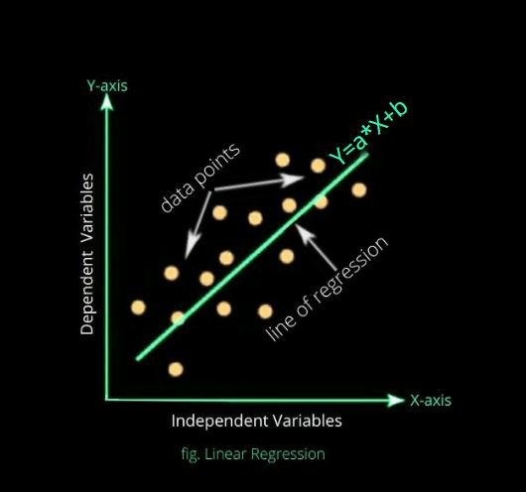

Slide 8
Examples of the linear regression model are:
Product sales prediction according to prices or promotions.
Call-center waiting-time prediction according to the number of complaints and the number of working agents.

Slide 9
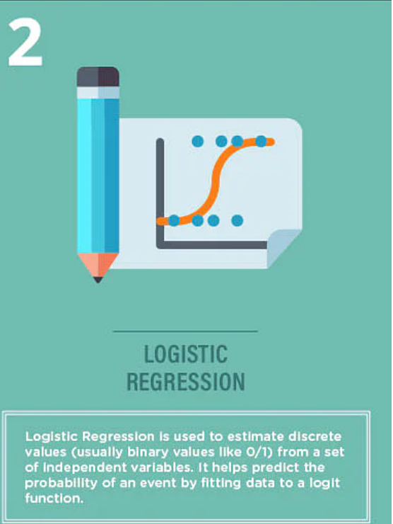
2.Logistic regression

Slide 10
2. Logistic Regression
Logistic Regression is used to estimate discrete values (usually binary values like 0/1) from a set of independent variables.
It helps predict the probability of an event by fitting data to a logit function.
It is also called logit regression.
These methods listed below are often used to help improve logistic regression models:
include interaction terms
eliminate features
regularize techniques
use a non-linear model

Slide 11
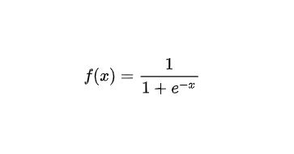
Representation of Logistic Regression:
Logistic regression is a linear method but predictions are transformed using the logistic function(or sigmoid).
The formula of the sigmoid function is:

Slide 12
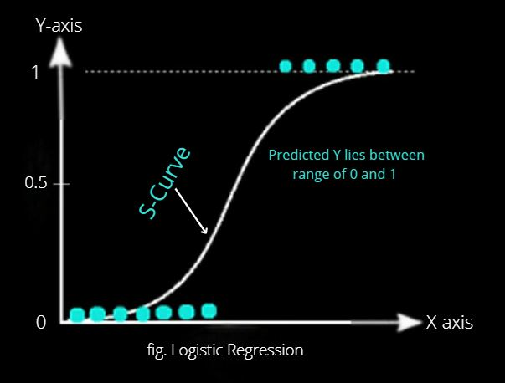
The graph for Logistic Regression

Slide 13
The graph for Logistic Regression
The sigmoid function forms an S-shaped graph and maps the real-valued numbers in (0,1).
Advantages of Logistic Regression:
It has a good classification baseline considering the simplicity
Possibility to change cutoff for precision/recall tradeoff
The probability output can be used for ranking
Examples of Logistic Regression are:
Classification of loan defaults according to profile
Customer scoring with the probability of purchase

Slide 14
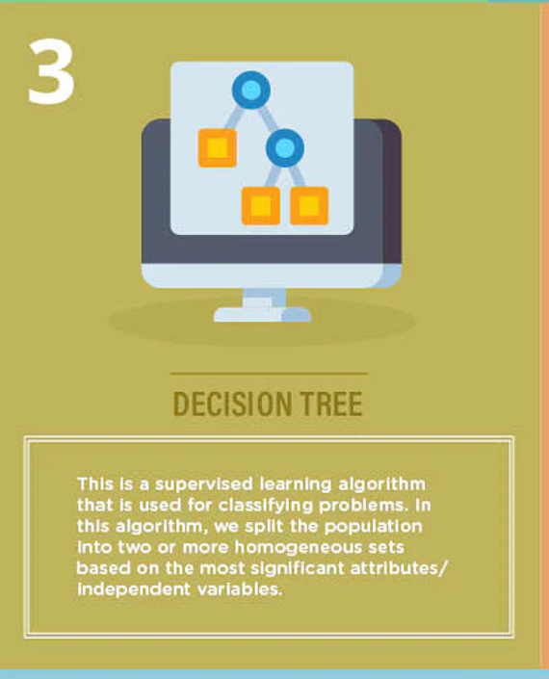
3.Decision tree

Slide 15
3. Decision Tree
Decision Tree algorithm in machine learning is one of the most popular algorithm in use today.
It is also referred to as CART or Decision Trees.
This is a supervised learning algorithm that is used for classifying problems.
It works well in classifying both categorical and continuous dependent variables.
This algorithm divides the population into two or more homogeneous sets based on the most significant attributes/ independent variables.

Slide 16
A decision tree is a flow-chart-like tree structure that uses a branching method to illustrate every possible outcome of a decision.
Each node within the tree represents a test on a specific variable and each branch is the outcome of that test.
Representation of Decision Tree:
The model representation is a binary tree, where each node is an input variable m with a split point and each leaf contains an output variable n for prediction.

Slide 17
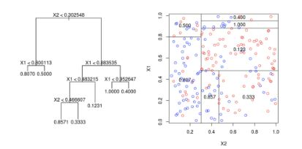

Slide 18
As, we can see from the diagram the model actually split the input space into (hyper) rectangles, and predictions are made according to the area observations fall into.
This is how the algorithm works.
Advantages of Decision Tree Algorithm:
The algorithm is easy to interpret and has no overfitting with the pruning.
It works for both regression and classification problems.
It can take any type of variable without modifications and does not require any kind of data preparation.
Examples of Decision Tree algorithm are:
Online shopping portal
Fraudulent transaction classification

Slide 19
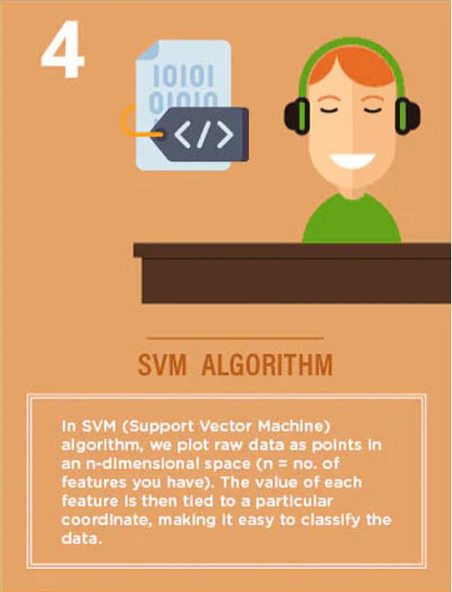
4.SVM algorithm

Slide 20
4. Support Vector Machine (SVM) Algorithm
SVM algorithm is a method of a classification algorithm in which you plot raw data as points in an n-dimensional space (where n is the number of features you have).
The value of each feature is then tied to a particular coordinate, making it easy to classify the data.
Lines called classifiers can be used to split the data and plot them on a graph.

Slide 21
Representation of SVM:
In the SVM, a hyperplane is selected to separate the points in the input variable space by their class, with the largest margin. The closest data points (defining the margin) are called the support vectors.
But real data cannot be perfectly separated, that is why a C defines the amount of violation of the margin allowed.

Slide 22
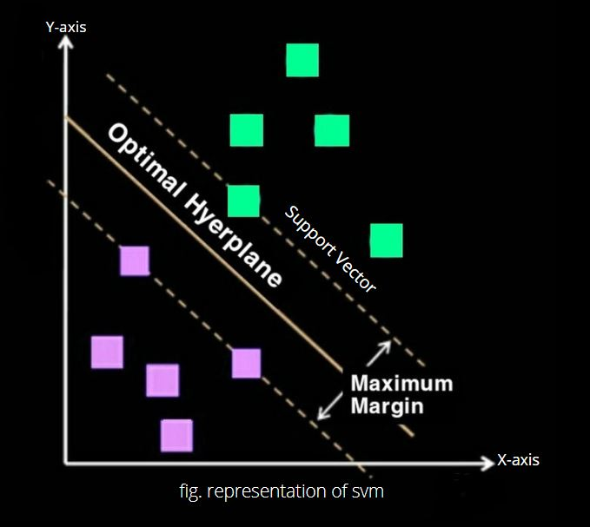

Slide 23
The plot shows the representation of SVM.
This is how we can use SVMs in classification problems. SVM assumes numeric inputs and may require a dummy transformation of categorical features.
Advantages of SVM:
It works well in high-dimensional space
It allows nonlinear separation with nonlinear Kernels
Examples of SVM are:
Face detection from images

Slide 24
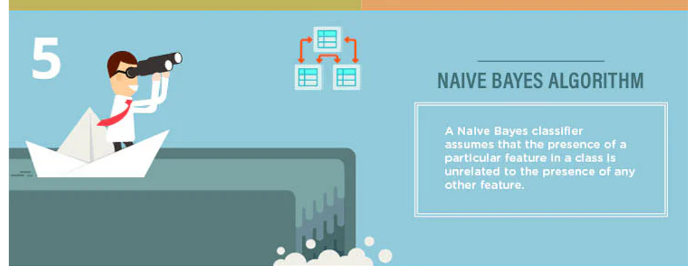
5.Naive Bayes algorithm

Slide 25
5.Naive Bayes algorithm
A Naive Bayes classifier assumes that the presence of a particular feature in a class is unrelated to the presence of any other feature.
Even if these features are related to each other, a Naive Bayes classifier would consider all of these properties independently when calculating the probability of a particular outcome.
A Naive Bayesian model is easy to build and useful for massive datasets.
It's simple and is known to outperform even highly sophisticated classification methods.

Slide 26
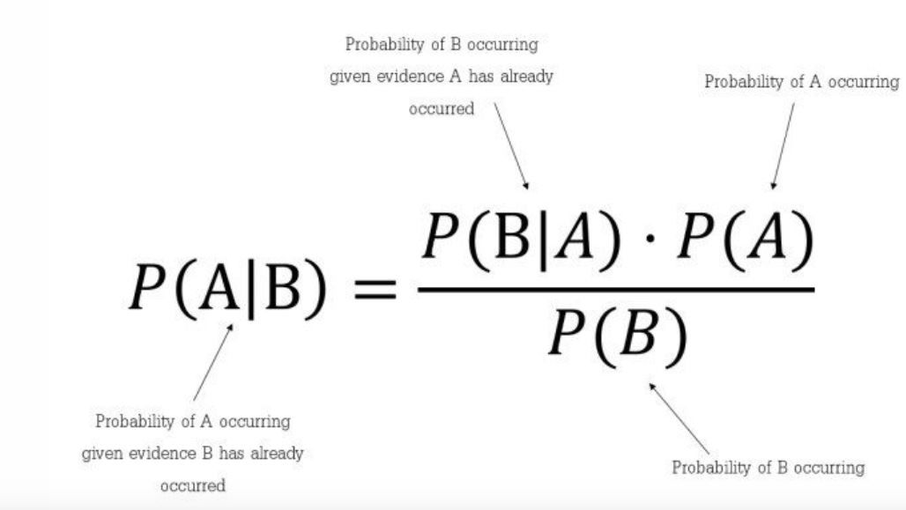
Representation of Naive Bayes:
It works on a simple mathematical formula used for calculating conditional probabilities.
The formula is:

Slide 27
Advantages of Naive Bayes algorithm:
It is a good algorithm for a few categories of variables
It is Fast because of the calculations
If the naive assumptions work can converge quicker than the other models. It can be used on smaller training data.
Examples of Naive Bayes are:
Email spam detection is a use case example of this algorithm
Article classification using binary word presence

Slide 28
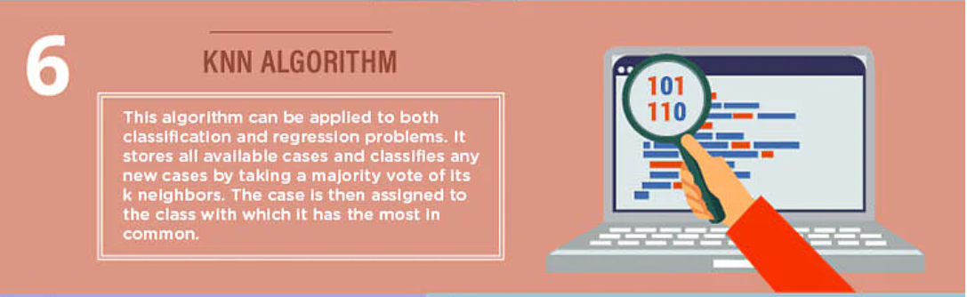
6. K- Nearest Neighbors (KNN) algorithm

Slide 29
6. K- Nearest Neighbors (KNN) algorithm
This algorithm can be applied to both classification and regression problems.
Apparently, within the Data Science industry, it's more widely used to solve classification problems.
It’s a simple algorithm that stores all available cases and classifies any new cases by taking a majority vote of its k neighbors.
The case is then assigned to the class with which it has the most in common.
A distance function performs this measurement.

Slide 30
6. K- Nearest Neighbors (KNN) algorithm
KNN can be easily understood by comparing it to real life.
For example, if you want information about a person, it makes sense to talk to his or her friends and colleagues!
Things to consider before selecting K Nearest Neighbours Algorithm:
KNN is computationally expensive
Variables should be normalized, or else higher range variables can bias the algorithm
Data still needs to be pre-processed.

Slide 31
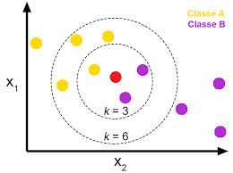
It is a versatile algorithm also used for imputing missing values and resampling datasets.
Representation of KNN:

Slide 32
As we can see from the above diagram with the help of KNN, we can easily identify the category or class of a particular dataset.
For regression, the output can be the mean, while for classification the output can be the most common class.
Various distances can be used, for example:
Euclidian distance – Euclidean distance is a formula that is used to calculate the distance of K number of neighbors.
It is good for a similar types of variables.

Slide 33

The euclidean distance formula is:
The best value of k must be found by testing, and the algorithm is sensitive to the Curse of dimensionality

Slide 34
Advantages of KNN:
KNN is effective if the training data is large
It is robust to noisy data, no need to filter outlier
Examples of KNN are:
Anomaly detection
Recommending products based on similar customers

Slide 35
Anomaly detection is a process of finding those rare items, data points, events, or observations that make suspicions by being different from the rest data points or observations.
Anomaly detection is also known as outlier detection.
Generally, anomalous data is related to some kind of problems such as bank fraud, medical problems, malfunctioning equipment, etc.
Finding an anomaly is the ability to define what is normal? For example, in the below image, the yellow vehicle is an anomaly among all red vehicles.

Slide 36
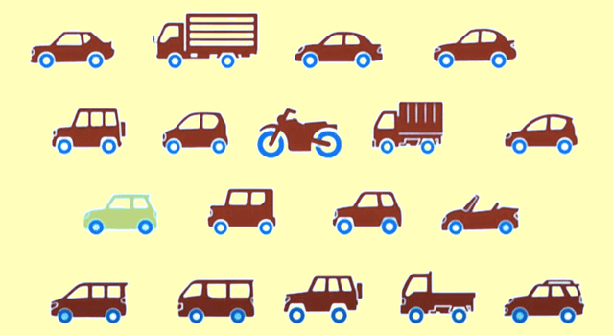

Slide 37
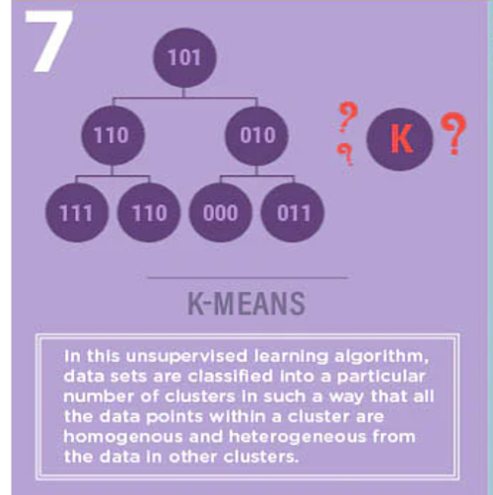
7.K-means

Slide 38
7.K-means
It is an unsupervised learning algorithm that solves clustering problems.
Data sets are classified into a particular number of clusters (let's call that number K) in such a way that all the data points within a cluster are homogenous and heterogeneous from the data in other clusters.

Slide 39
7.K-means
How K-means forms clusters:
The K-means algorithm picks k number of points, called centroids, for each cluster.
Each data point forms a cluster with the closest centroids, i.e., K clusters.
It now creates new centroids based on the existing cluster members.
With these new centroids, the closest distance for each data point is determined.
This process is repeated until the centroids do not change.

Slide 40
Representation of K-Means:
Step 1: It first selects the number K to decide the number of clusters, these random K points are called centroids.
Step 2: Now, categorize each item to its closest mean and update the mean’s coordinates, which are the averages of all the items categorized in that cluster so far.
Step 3: This process is repeated until the centroids do not change.

Slide 41
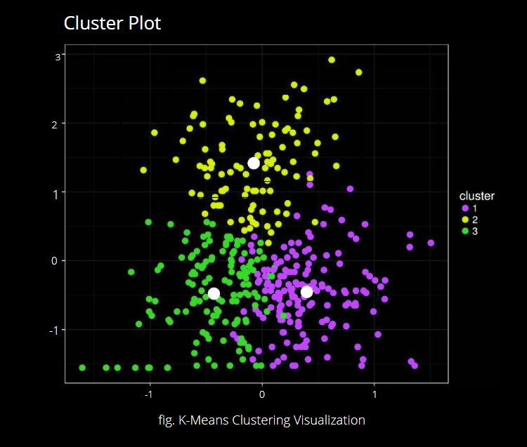

Slide 42
Advantages of K-Means:
Simple clustering approach
Apply even in case of large data sets
The algorithm can guarantee the result
Usecase examples of K-Means Clustering:
Identifying Fake News
Marketing and Sales

Slide 43
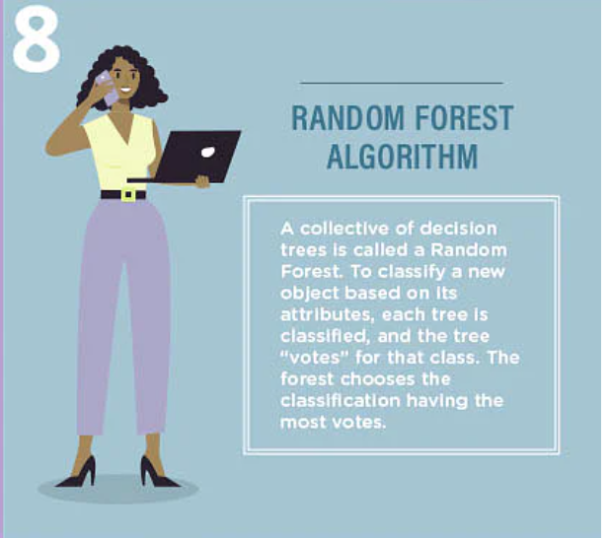
8.Random forest algorithm

Slide 44
8. Random Forest Algorithm
8. Random Forest Algorithm
A collective of decision trees is called a Random Forest.
To classify a new object based on its attributes, each tree is classified, and the tree “votes” for that class.
The forest chooses the classification having the most votes (over all the trees in the forest).

Slide 45
8. Random Forest Algorithm
Each tree is planted & grown as follows:
If the number of cases in the training set is N, then a sample of N cases is taken at random.
This sample will be the training set for growing the tree.
If there are M input variables, a number m<<M is specified such that at each node, m variables are selected at random out of the M, and the best split on this m is used to split the node.
The value of m is held constant during this process.
Each tree is grown to the most substantial extent possible.
There is no pruning.

Slide 46
Random forests or random decision forests are a bigger type of ensemble learning method called as Bootstrap Aggregation or Bagging, combining multiple algorithms to generate better results for classification, regression, and other tasks.
Each individual classifier is weak, but when combined with others, can produce excellent results.
The algorithm can handle the data set containing continuous variables as in the case of regression and categorical variables as in the case of classification

Slide 47
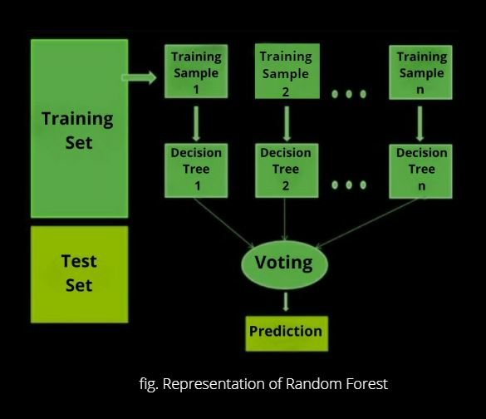

Slide 48
The working of the algorithm consists of the following steps:
Step 1: First, select the random X data points from the training set.
Step 2:Now, with the selected data points (Subsets), build the decision trees.
Step 3: In this step, we will choose the number Y for the decision trees that you want to build. Hence, from every decision tree, we will get the prediction result.
Step 4: After this, for every predicted result voting will be performed. Finally, select the most voted prediction result as the final prediction result.
This is how the Random Forest algorithm works.

Slide 49
Advantages of Random Forest algorithm:
The random forest produces good predictions that can be understood easily.
It can handle large datasets efficiently.
Examples of Random Forest algorithm:
Banking to detect customers who are more likely to repay their debt on time.
Stock traders use Random Forest to predict a stock’s future behavior.

Slide 50
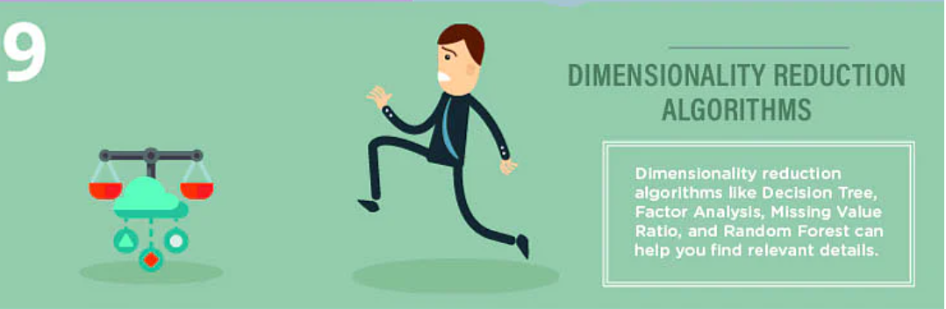
9.Dimensionality reduction algorithms

Slide 51
9.Dimensionality reduction algorithms
In today's world, vast amounts of data are being stored and analyzed by corporates, government agencies, and research organizations.
As a data scientist, you know that this raw data contains a lot of information - the challenge is to identify significant patterns and variables.
Dimensionality reduction algorithms like Decision Tree, Factor Analyses, Missing Value Ratio, and Random Forest can help you find relevant details.

Slide 52
“Dimensionality Reduction” simply refers to the process of reducing the number of attributes in a dataset while keeping as much of the variation in the original dataset as possible.
By applying dimensionality reduction, you can decrease or bring down the number of columns to quantifiable counts, thereby transforming the three-dimensional sphere into a two-dimensional object.
Dimensionality reduction algorithms like Decision Trees, Factor Analysis, Missing Value ratios, and Random Forest can help you find relevant/accurate details.

Slide 53
Advantages of Dimensionality Reduction Algorithm:
It makes machine learning algorithms computationally efficient.
It helps in data compression by reducing features.
It reduces storage.

Slide 54
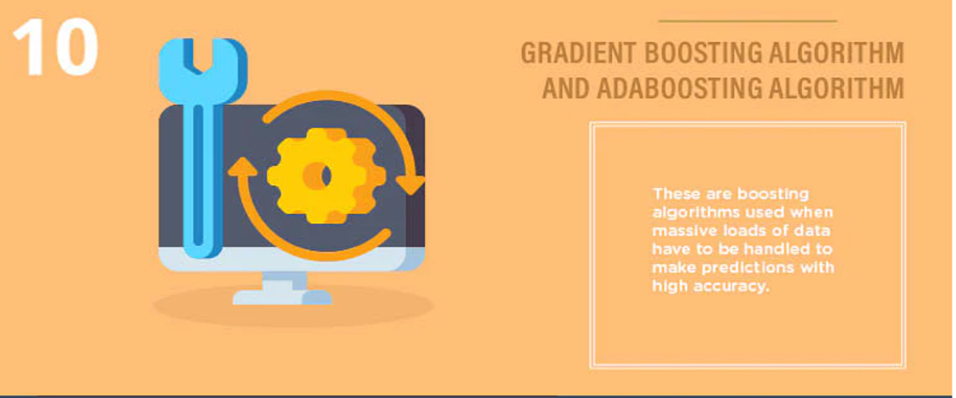
10.Gradient boosting algorithm and AdaBoosting algorithm

Slide 55
10. Gradient Boosting Algorithm and AdaBoosting Algorithm
Gradient Boosting Algorithm and AdaBoosting Algorithm are boosting algorithms used when massive loads of data have to be handled to make predictions with high accuracy.
Boosting is an ensemble learning algorithm that combines the predictive power of several base estimators to improve robustness.
In short, it combines multiple weak or average predictors to build a strong predictor.
These boosting algorithms always work well in data science competitions like Kaggle, AV Hackathon, CrowdAnalytix.
These are the most preferred machine learning algorithms today.
Use them, along with Python and R Codes, to achieve accurate outcomes.

Slide 56

Representation of algorithm:
Adaboost classifier is of the form given below:
where each 𝑓_{t} is a week learner correcting the errors of the previous one.

Slide 57
“Adaboosting” is an ensemble learning method, commonly used with decision trees with one level. For the purpose of data, preparation outliers should be removed for AdaBoost.
Advantages of the Algorithm are:
It is easier to use with less need for tweaking parameters.
The accuracy of weak classifiers can be improved by using Adaboost.
It is less prone to overfitting as the input parameters are not jointly optimized.

